Slide 1
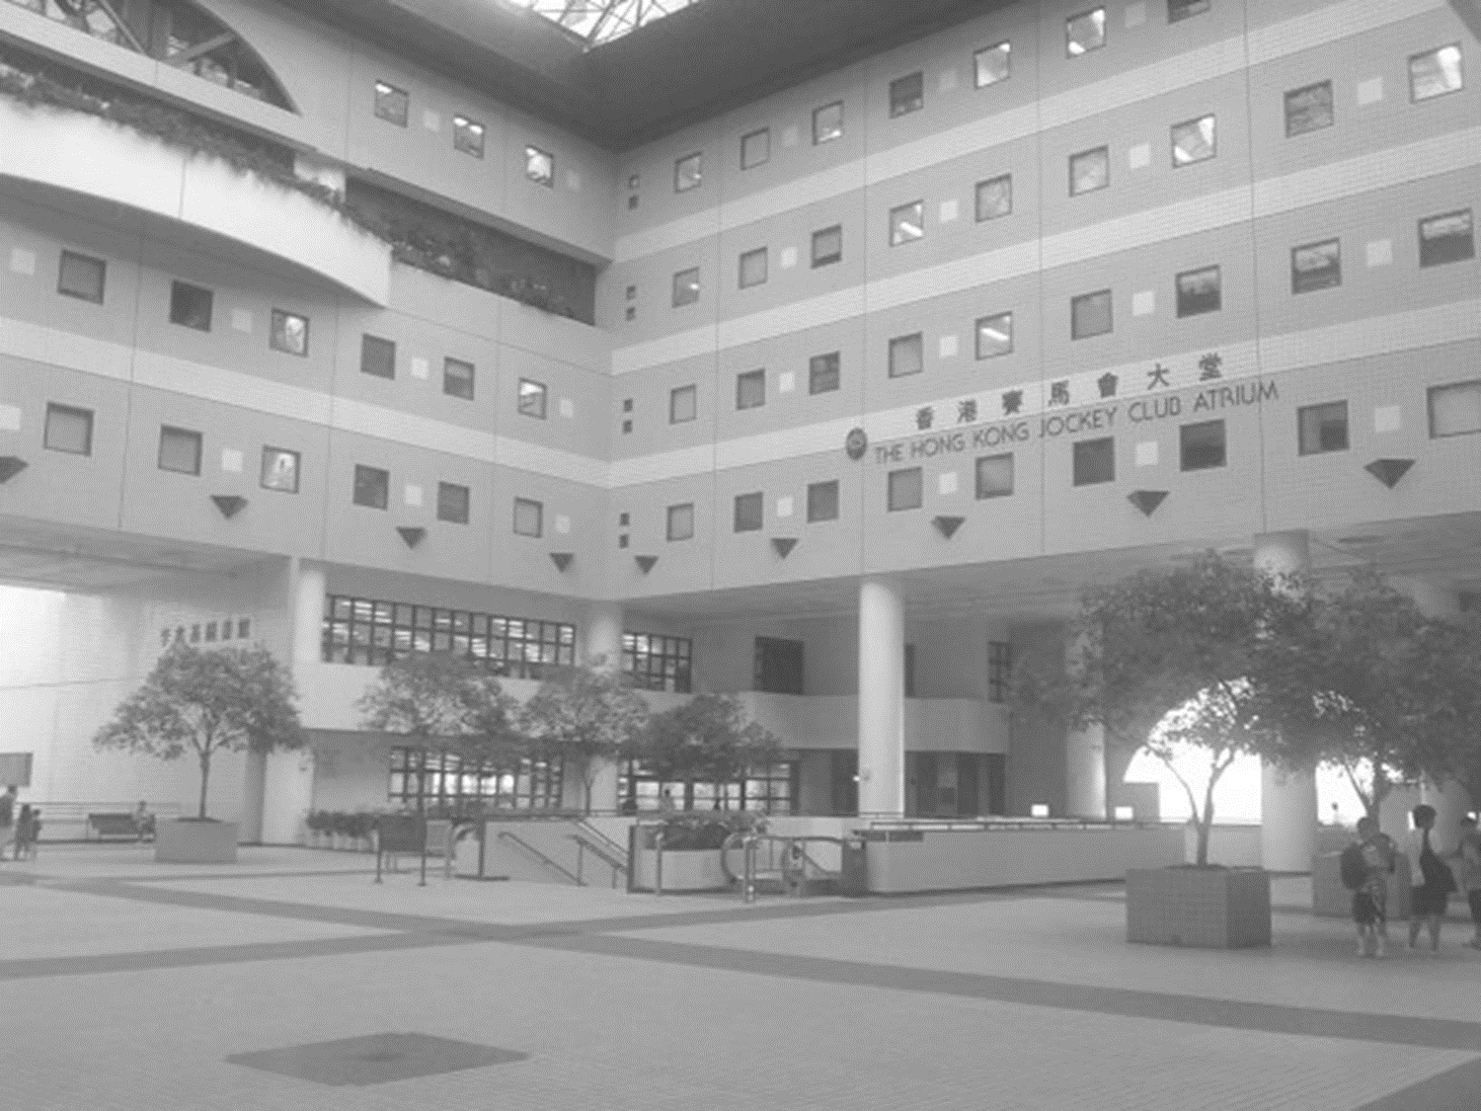
HKUST Atrium
COMP3111 Project
HO CHEUK HEI BRIAN
HSIEH MAN YEE
SZETO SAI KIT
TANG KWONG LUN
WONG KRIT

Slide 2
Introduction
This project is built on Android platform
  Featuring at UST-related applications
  Providing an integrated solution to the users
  Convenient to our daily lives
6 Applications
  1. Student Timetable Assistant
  2. GPA Calculator
  3. Academic Advisor
  4. HKUST Map
  5. Discussion Platform
  6. Useful Links

Slide 3
Importance
Two main directions
  To assist HKUST students with useful mobile applications
  To integrate through functions together into one application with a user friendly interface
That is what we proposed to make and why we focus on it. It is very important as we want to help students in daily life in more aspects.

Slide 4
Applications
1. Student Timetable Assistant
  Generates timetable automatically
  Helps users to compute the conflicts between courses
  Computes the best arrangement to give a day off
  Helps to avoid time gaps between lessons
2. GPA Calculator
  Inputs target CGA and user GPA information
  Grades improvement suggestions
  CGA calculation
3. Academic Advisor
  Study path recommendation
  Chatting platform
  List of office hours of professors and offices.

Slide 5
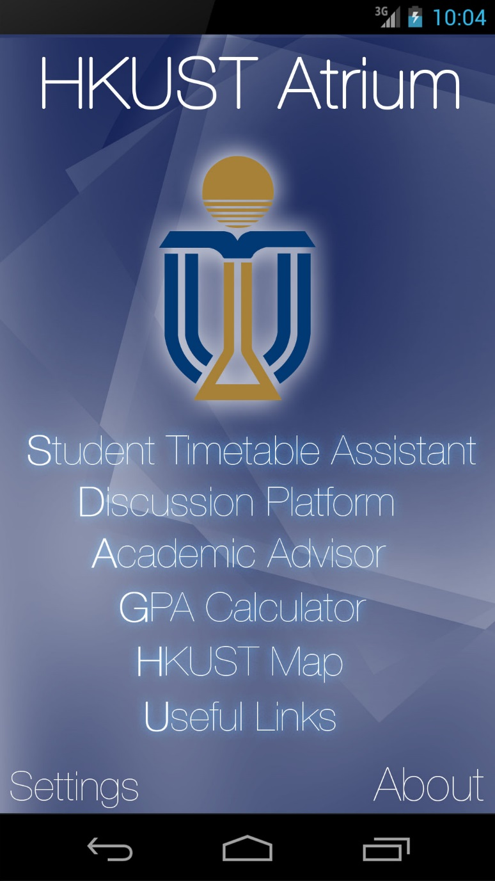
Applications
4. HKUST Map
  NEW map
  Lists out the location of each room
  Empty room
  Occupied room
5. Discussion Platform
  Course discussion
  HKUST Secret
  HKUST Dry club
  More
6. Useful Links
  Links of websites related to HKUST
    Print budget
    Snapshot of Computer Barn
    Bus Stations Live View
5

